Slide 1
Management Issues in Southern New England Lobster Stock
Penny Howell
Atlantic States Marine Fisheries Commission
Lobster Technical Committee

Slide 3
US Lobster Landings

Slide 4
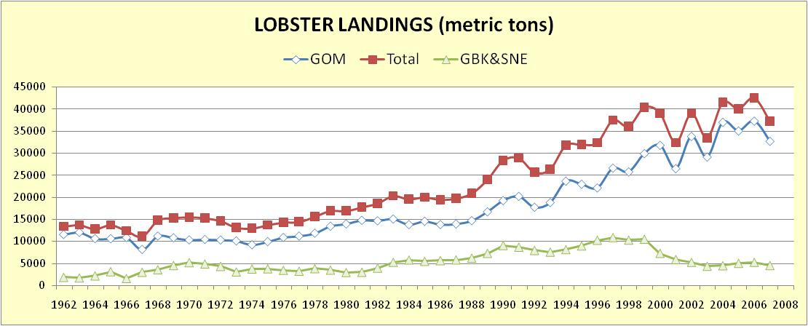

Slide 5
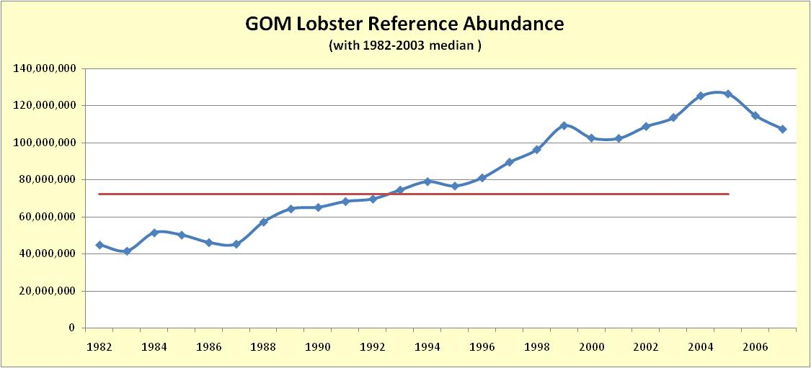

Slide 6
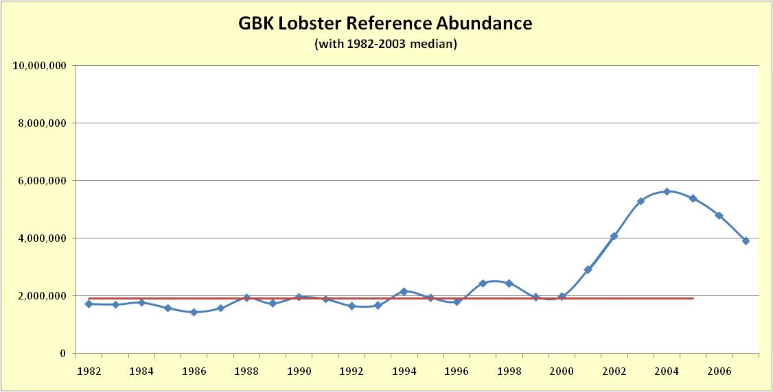

Slide 7
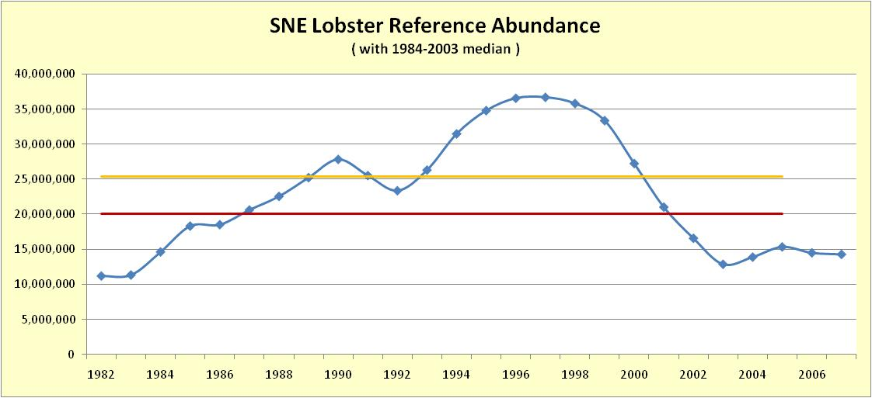

Slide 8
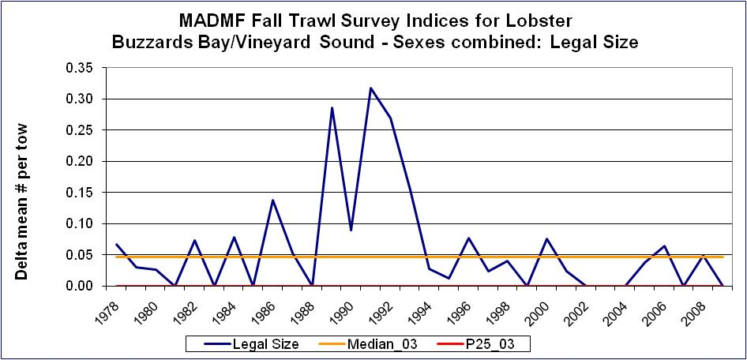
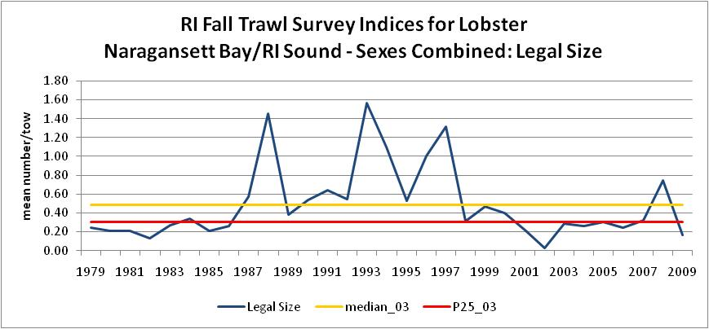
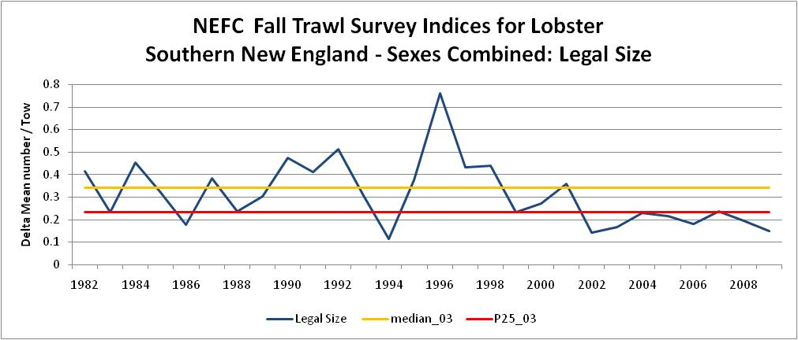
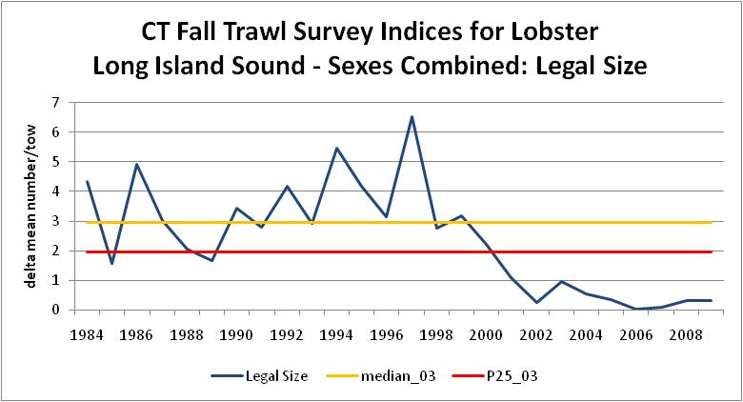
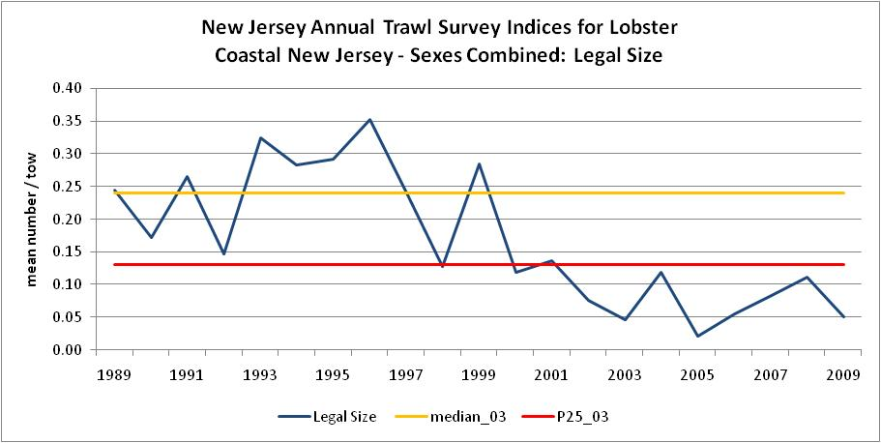

Slide 9
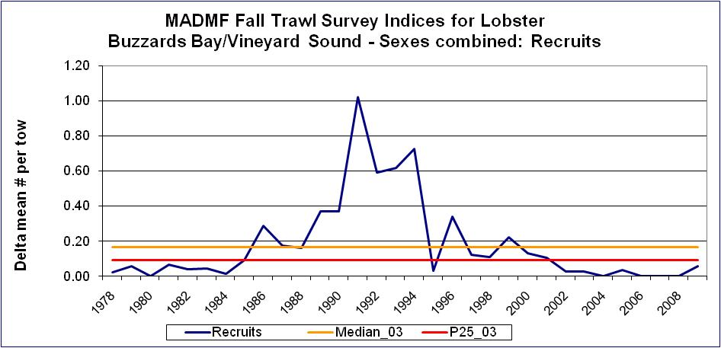
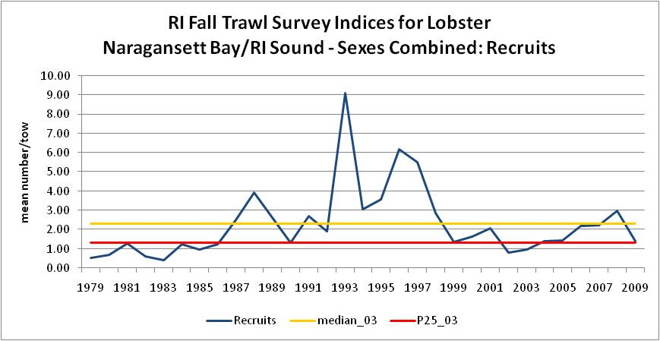
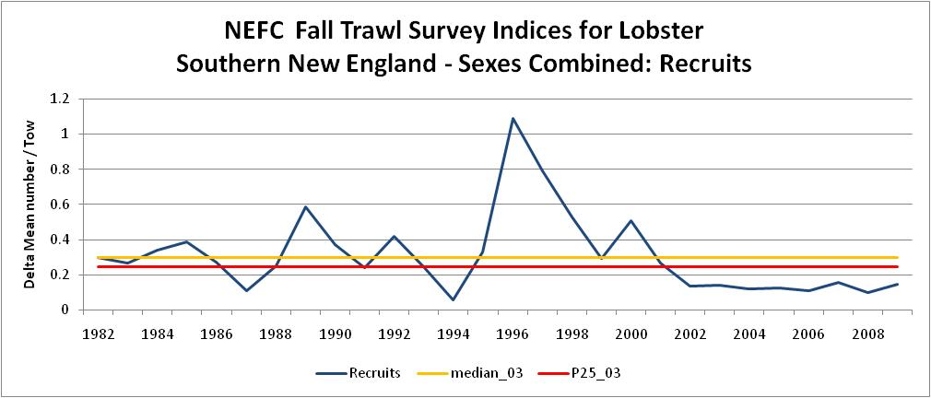
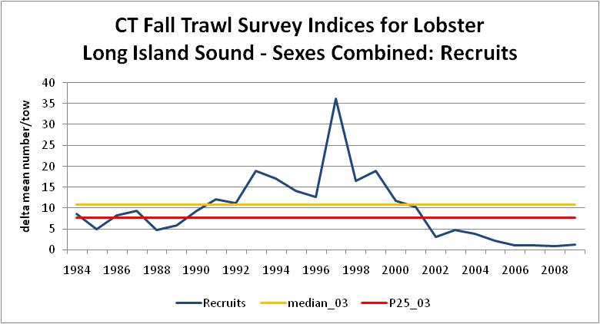
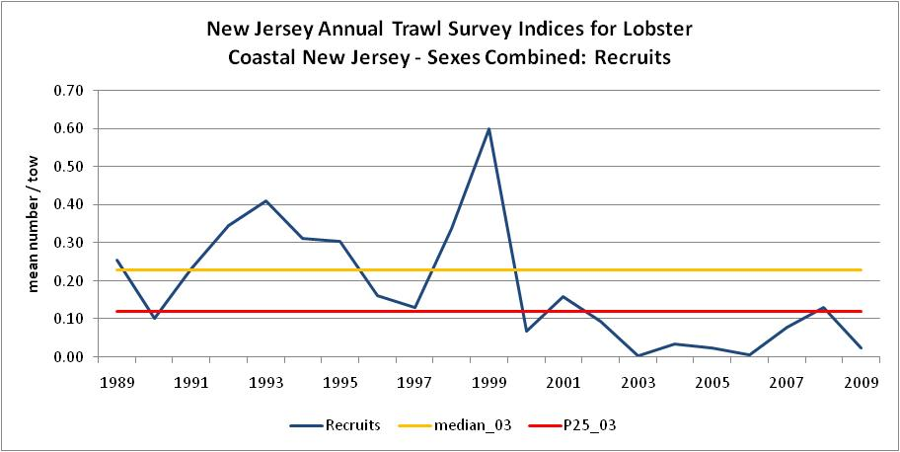

Slide 10
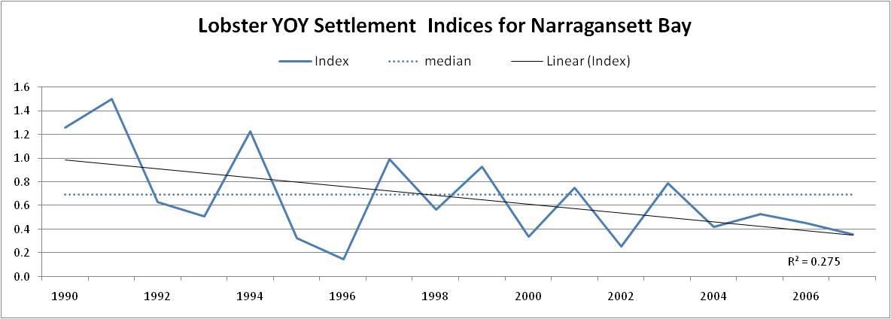
Narragansett Bay Lobster Settlement Index

Slide 11
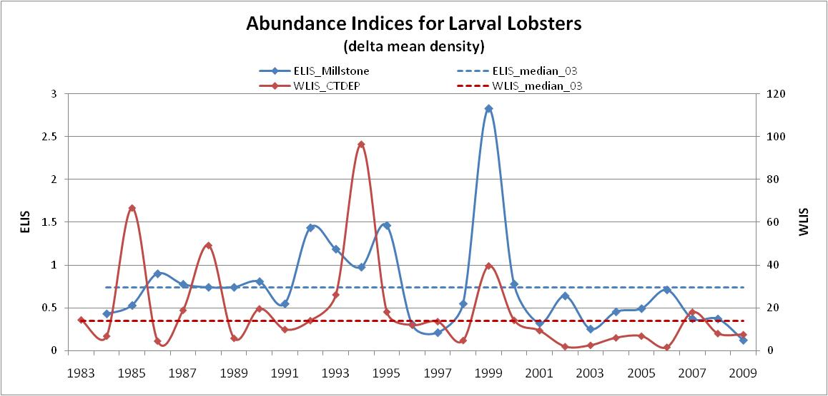
Note: Millstone station shut down 1996-1997, circulation pumps only.
Data provided courtesy of Dominion Nuclear Connecticut

Slide 12
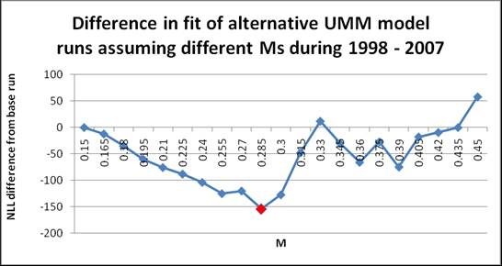
Note: a lower NLL difference indicates a statistically better fit to the data

Slide 13
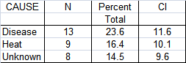
Laboratory mortality of healthy and diseased lobsters exposed to high water temperatures
Data taken from: B. Stevens, 2009. Diseases of Aquatic Organisms, 88:25-34.

Slide 14
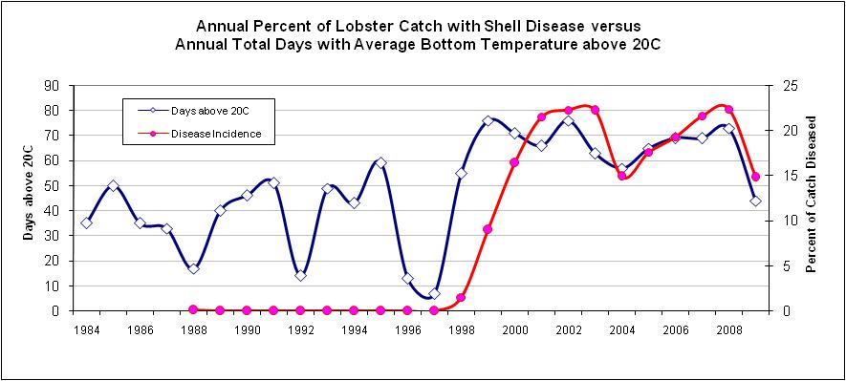
ELIS: Millstone Power Station
Data provided courtesy of Dominion Nuclear Connecticut

Slide 15
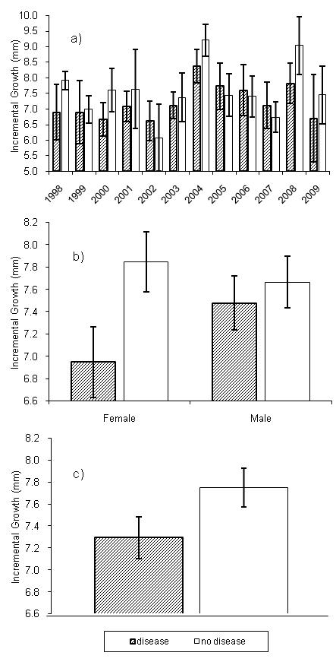
GROWTH of DISEASED AND HEALTHY ANIMALS molt increment based on recapture of tagged lobsters with shell disease (n= 838) and without shell disease (n= 922)
Data provided courtesy of Dominion Nuclear Connecticut

Slide 17
HYPOTHETICAL PROCESS OF SNE STOCK DECLINE
UNDERLYING STRESS (temperature, others?)
CHRONICALLY DISEASED
REDUCED GROWTH
REDUCED REPRODUCTION

Slide 18
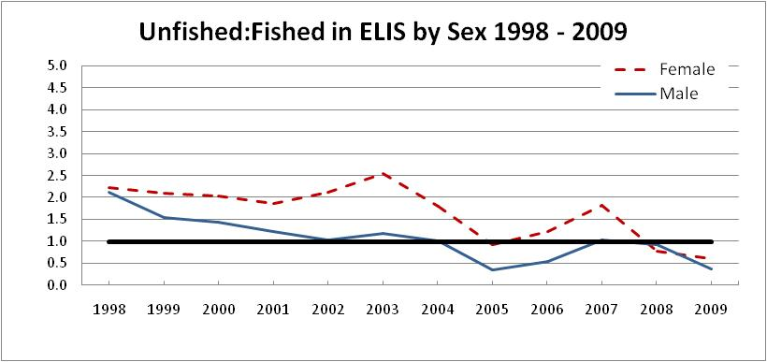
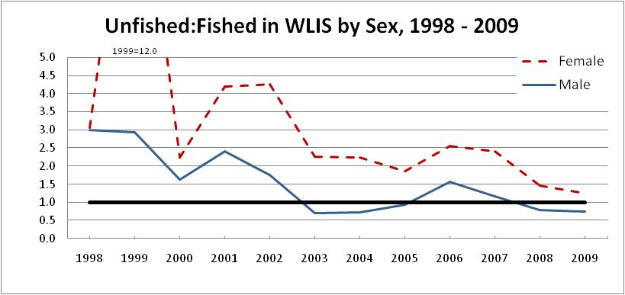
Changes in the Catch of Sub-legal and Legal Size Lobsters (no change in vent size)r

